Slide 1
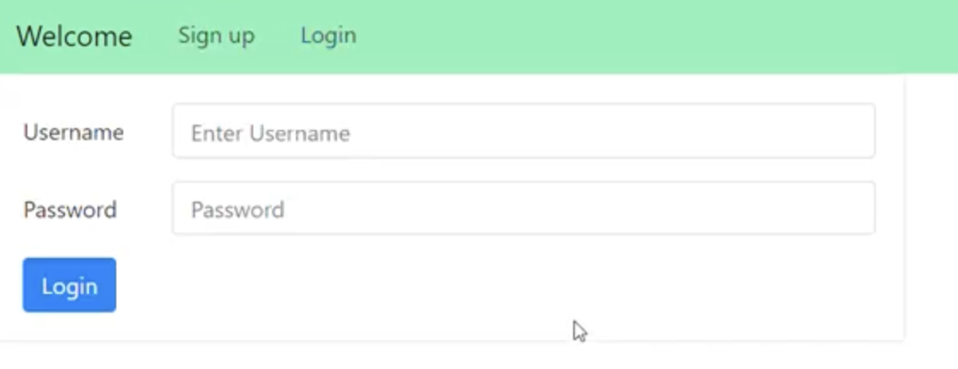
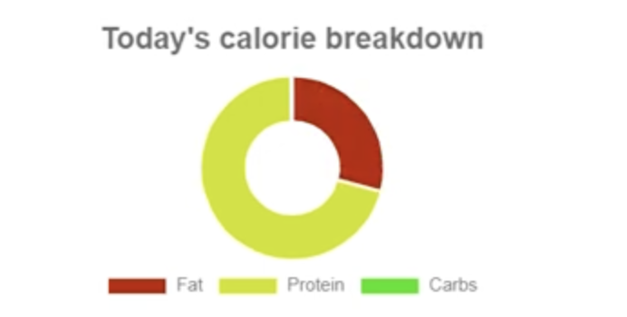
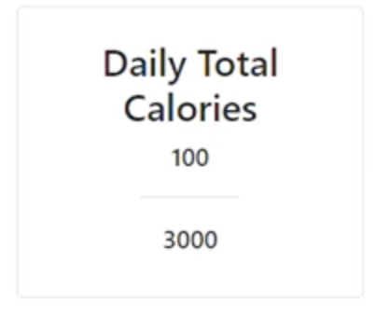
SUMMARY
Calorie Tracker Application
Software Engineering
2021-2022 Capstone Project
Furkan SUCU
The need for simple, user-friendly applications for people to keep track of calories and keep your health in a good condition.
RESULT & DISCUSSION
People would be able to track calories instantly with a single tap.
Users will have the ability to add or delete food to keep track of their personal calories and weight.
Users will be able to track calories with graphs.
Users can see the total calories they need to take.
In order for people to easily follow their health status and to eat the calories of the food produced during the day, to eat according to an order or to have an existing regular diet.
INTRODUCTION
Connecting user to the Avalanche blockchain in the fastest and most efficient way. Creating customizable interface where users can add new assets or interact them on their portfolio and easily tracking crypto prices on homepage.
Giving people the opportunity to increase their savings with staking.
Designing smooth and understandable interface for people who newly stepped in cryptocurrency world.
Follow the crypto news instantly.
RECOMMENDATIONS
To support people.
To lose weight healthily.
Figure 1 – Login page.
Figure 2 – Adding food to the meal portion
Figure 3 –Examining the nutritional elements of a pie chart.
METHOD
One of the methods used for this purpose is to personal page. For this, the user sets a password on account.
On the other hand, our second method is to be able to customize. For this purpose, users can add the foods they want and learn the calorie, view the graph, add and remove them from their meal.
In the application, users are able to add their current weight with a single button.
With the adding method, you can see the daily calorie for a certain period of time. With the another adding method, the food has the category and stored in a database. (Planned but failed find a food database.)
RESOURCES
Creating serializers and custom APIs using Django Rest Framework
Back end user authentication using Django-rest-knox
Consuming REST APIs with React/Redux
Framework that is for developing interfaces: React
Database for storing : SQLite
Visual Studio Code
Figure 4 -Reviewing total daily calorie intake
Figure 5 – Tracking daily calorie consumption from graphs
Figure 6 – Tracking your daily weight from the chart

