Slide 1
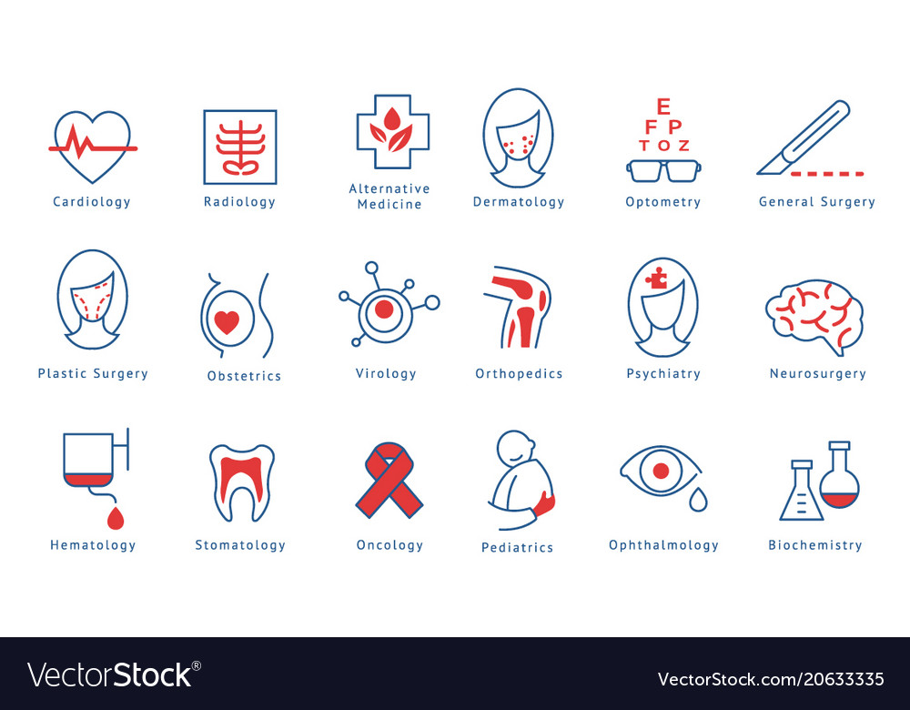
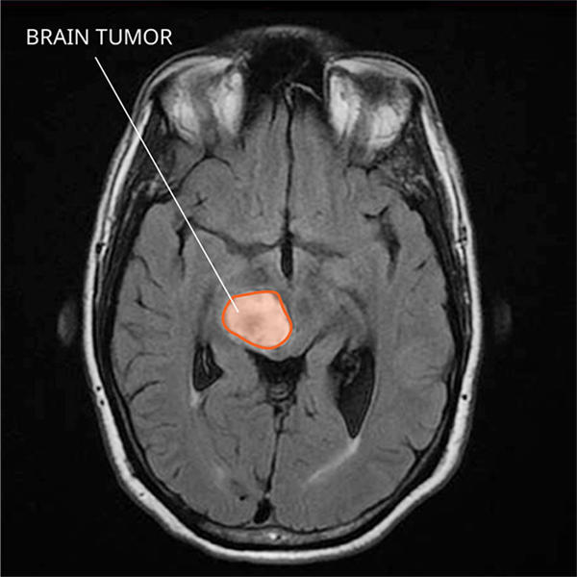
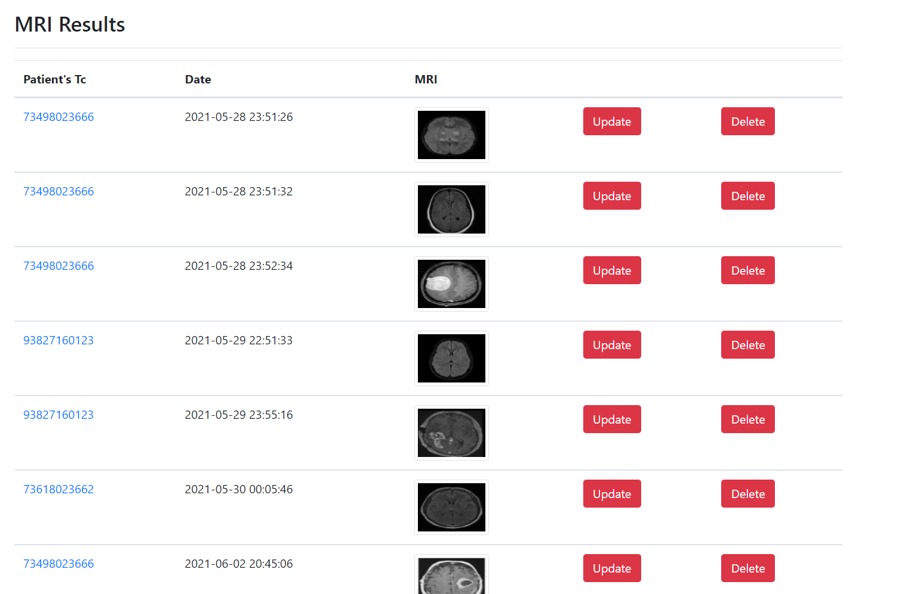
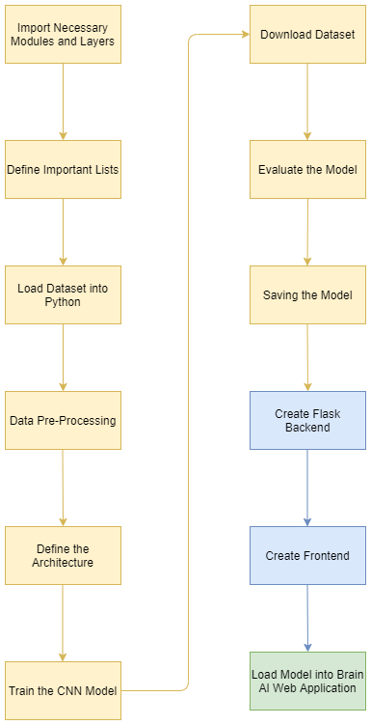
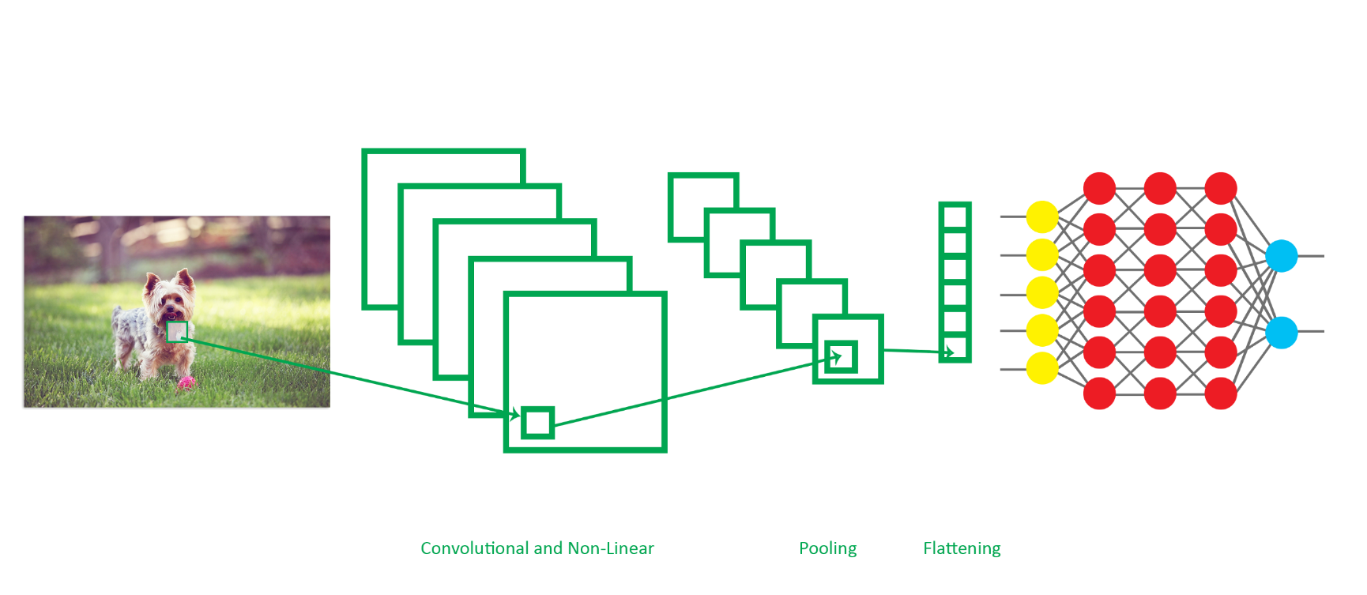
ABSTRACT Brain AI is a web application that detects brain tumors with MRI (Magnetic resonance imaging) images. This web application, developed by integrating deep learning model, has both doctor and patient login. Doctors upload MRI images of their patients to the application, and the application detects whether there are tumors in the MRI image. Then, doctors can update these diagnoses. Patients can check their diagnosis by entering the application.
A Web Application in Healthcare that Detects Brain Tumors
Integrated with the Deep Learning Model
Fatmanur Akbaş
16 07 06 027
Software Engineering
2020-2021 Capstone Project
PROBLEM DEFINITION
The radiology specialty seems to be one of the most risk-free branches, it is a profession where it is important to see every detail and to view the smallest image. Sometimes doctors need an assistant when detecting disease from MRI images.
The product developed in this project is a deep learning integrated web application that supports doctors in the brain tumor diagnosis phase.
Diagnoses are recorded in the application and the doctor can see and manage them at any time. In addition, patients who are registered to the system with their Turkish identification numbers, can see their own diagnosis when they enter the application.
CONCLUSION and DISCUSSION Doctors can get help from the deep learning model in brain tumor detection, using this application. They can easily update and delete the diagnoses they have entered before. In addition, patients who are registered to the system with their Turkish identification numbers, can see their own diagnosis when they enter the application.
INTRODUCTION
PROJECT DETAILS
This project is a web application integrated with a deep learning model, developed to detect brain tumors. The homepage welcomes the user who enters the application. User registers on the website by selecting the "Sign Up" option from the top navigation bar. The information that must be entered into the system for registration is as follows; name, surname, Turkish identification number, e-mail, date of birth, gender, password and role. ID numbers are checked during registration. For users who already have an account, they are directed to the login page by clicking the link that says I already have an account. They sign in by entering their Turkish identification number, password and role on this page. Also on this page, the users enters their e-mail by clicking on the “Forgot Password” link. A password reset link is sent to the entered email. When this link is clicked, the user is directed to the password reset page and renews the password. If the logged in user is a doctor, she/he can benefit from the AI service part. The doctor who clicks on AI Service (session is checked) sees 3 options:
The growth and formation of abnormal cells that occur in copying during the regeneration of brain cells is called a brain tumor. Brain tumor, which can be seen at any age from newborns to elderly people, causes pressure inside the skull. This pressure makes the brain unable to perform its task fully, and patients show various symptoms.
The diagnosis of brain tumor is made as a result of imaging methods, medical history of the patients and neurological examination. Magnetic Resonance (MR) and brain tomography are the primary methods used during diagnosis.
This project is a web application that detects brain tumors with MRI(Magnetic resonance imaging) images. This web application, which develops by integrating deep learning models, presents the user with forward-looking statistical estimates and graphs by storing the user's personal information and analysis.
SUGGESTION
A machine learning model could be integrated that predicts brain strokes based on personal information for users in the patient role.
Deep learning models could be developed for an assistant diagnosis specific to all hospital departments and diseases.
Brain Tumor Detection: In this option, Doctor enters the patient's Turkish identification number and MRI images. Then, when the Detect button is clicked, it is determined whether the patient has a tumor in her/his brain. In this section, the CNN (Convolutional Neural Networks) model trained with 3000 data is used. Diagnoses detected here are recorded in the database.
RESOURCES
METHODS
The project was developed in PyCharm.
For the frontend, html, css, javascript, bootstrap were used.
Flask framework and python programming language are used in the backend.
Keras, Scikit-learn, Numpy, Matplotlib libraries were used in data preprocessing, model development and model evaluation stages
View MRI Detection Results: In this option, it is only accessible to users who are doctors. In chronological order, doctors view the MRI results they entered. In this section, the doctor can view, update and delete diagnostics.
Chart: In this section, the ratio of the number of patients with and without tumors is visualized with a pie chart graph.
In the diagram above, the stages of all the methods developed from the beginning to the end of the project are outlined.
Convolutional neural network (CNN) is used for the task of detection brain tumor in this project. The modules and functions used are imported and the implementation begins.
Diagnosis: In this module, users who are doctors can see the analysis details of all the patients they enter. However, patient users can only see their own MRI images and results.
Dataset
https://www.kaggle.com/ahmedhamada0/brain-tumor-detection
Similar Project
https://www.researchgate.net/publication/350431752_BRAIN_TUMOR_DETECTION_USING_CONVOLUTIONAL_NEURAL_NETWOKS

