Slide 1
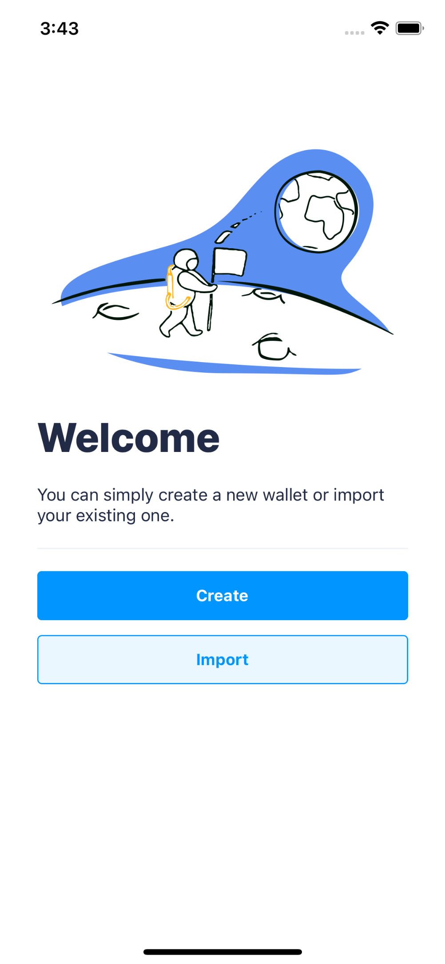
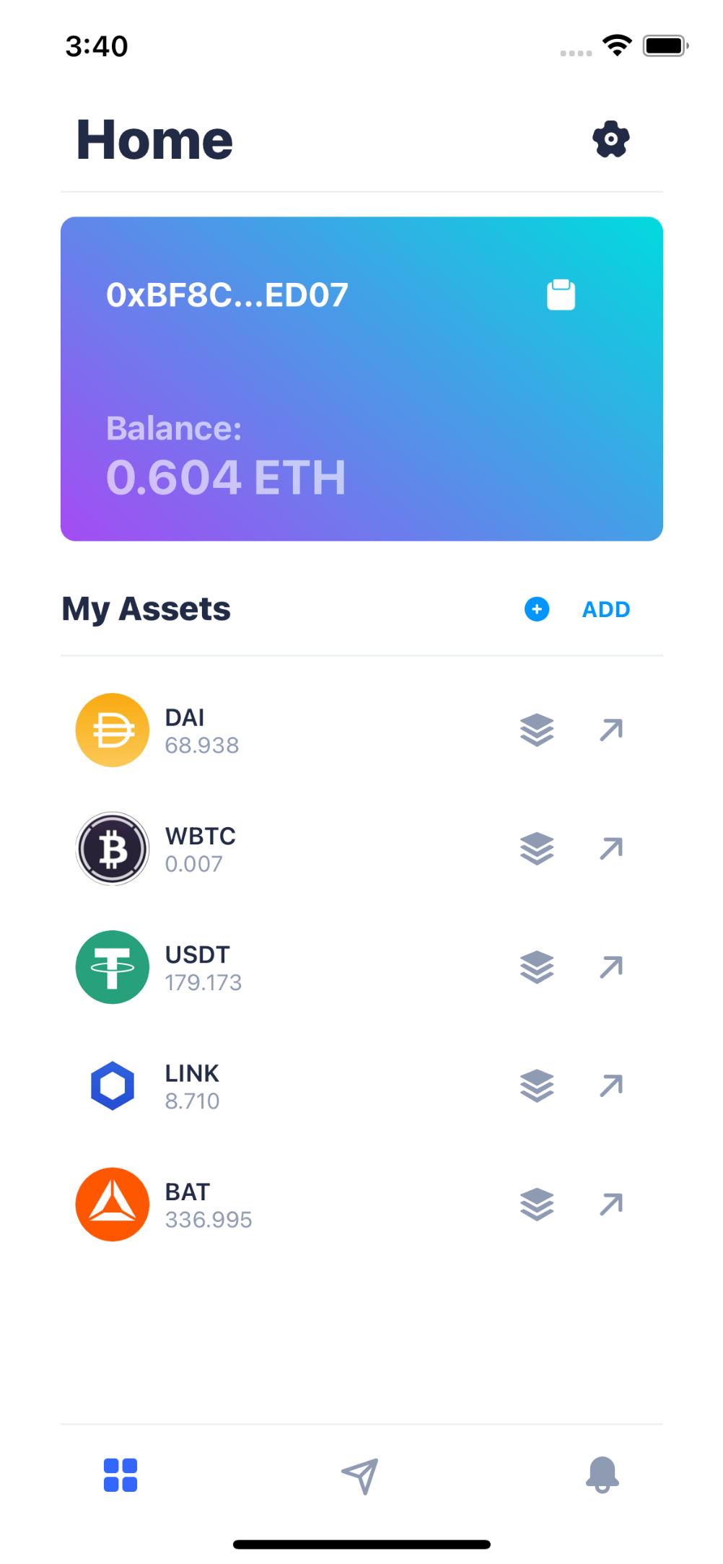
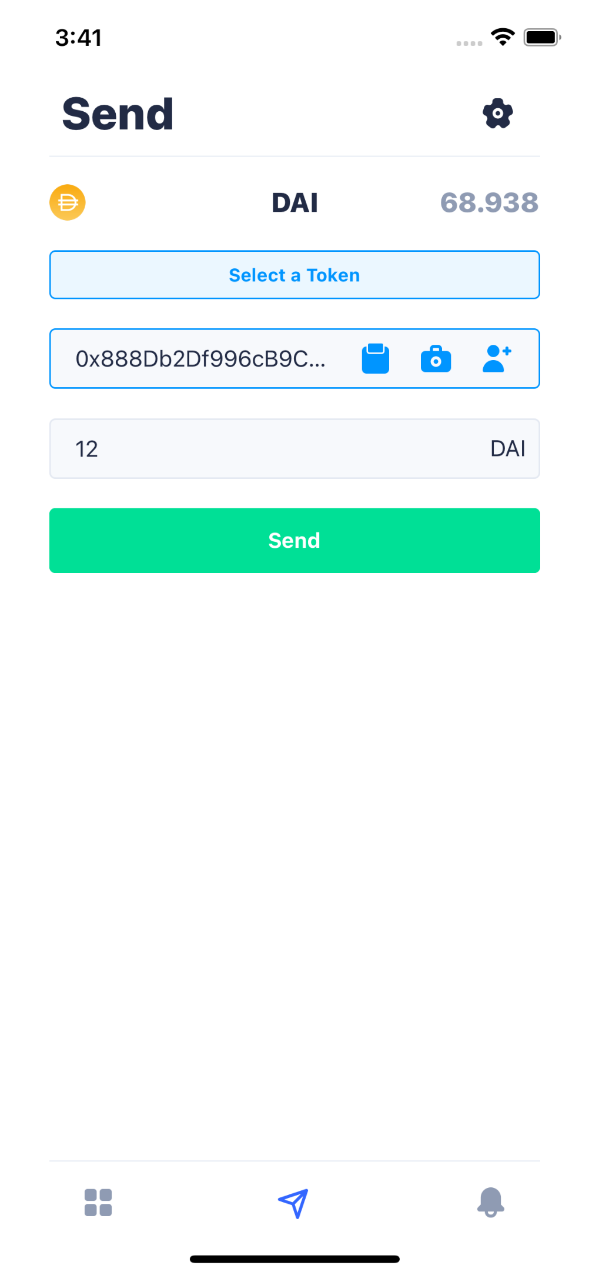
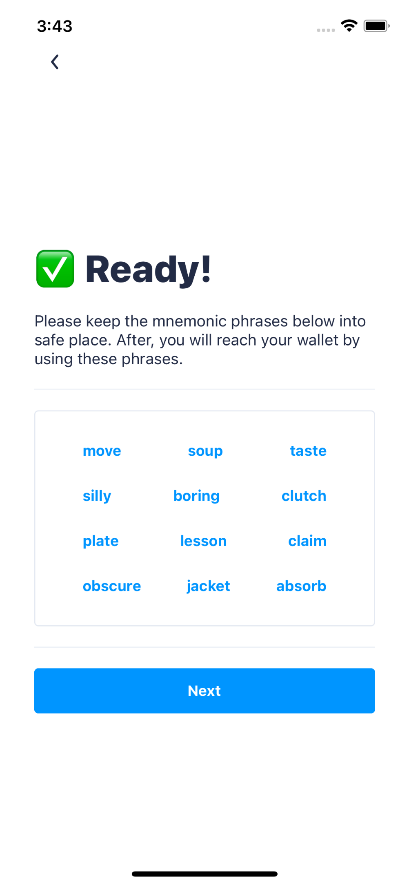
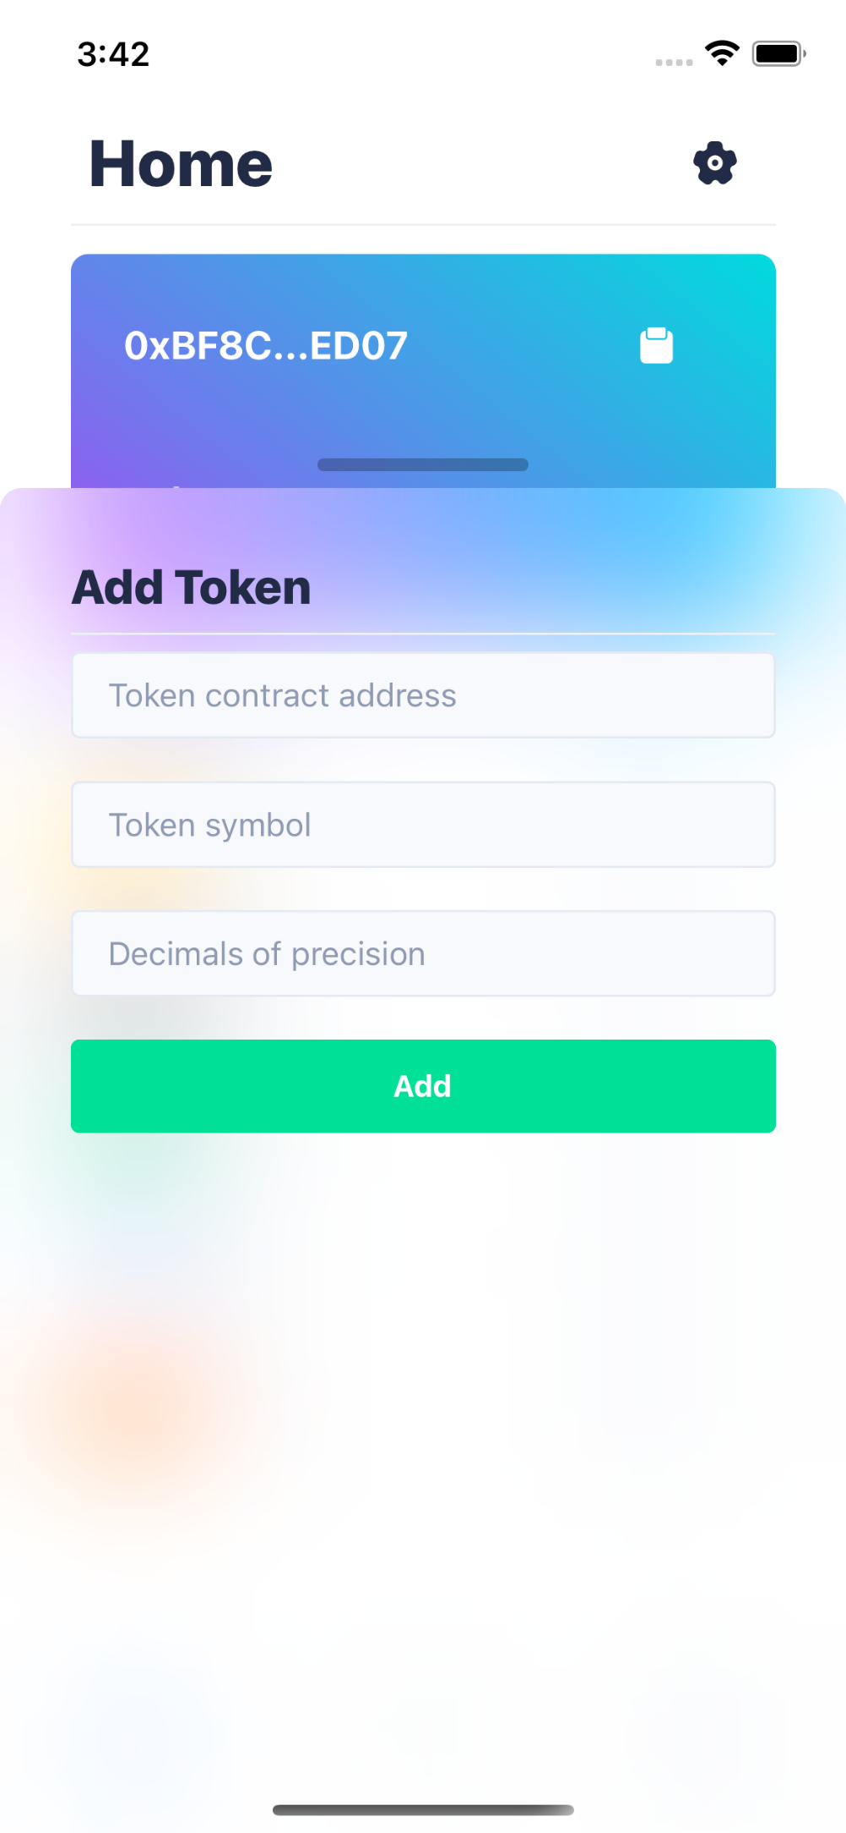
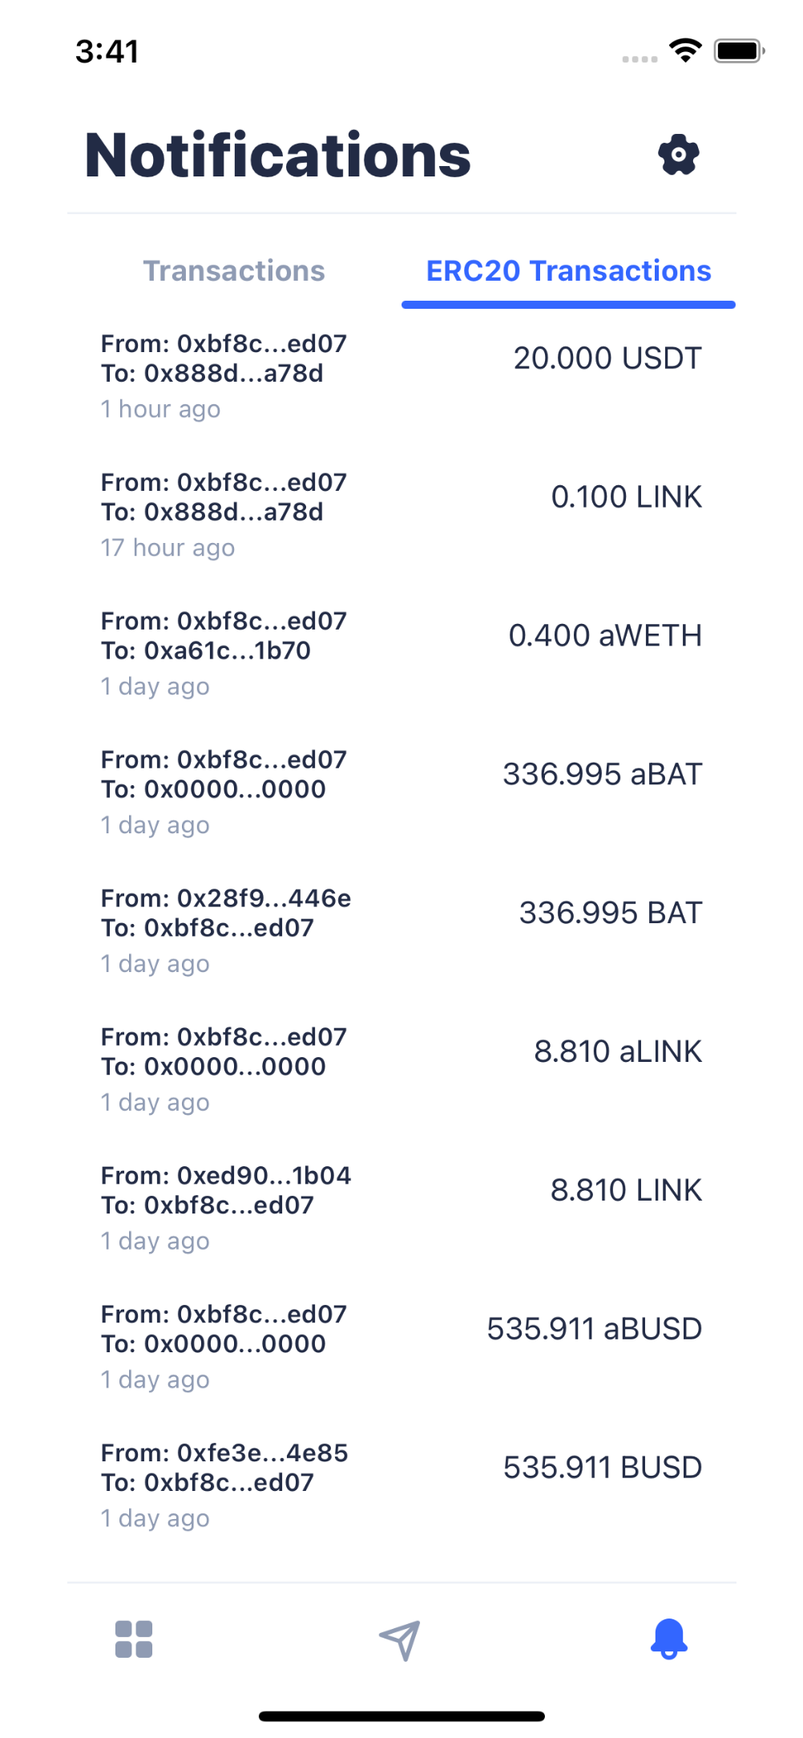
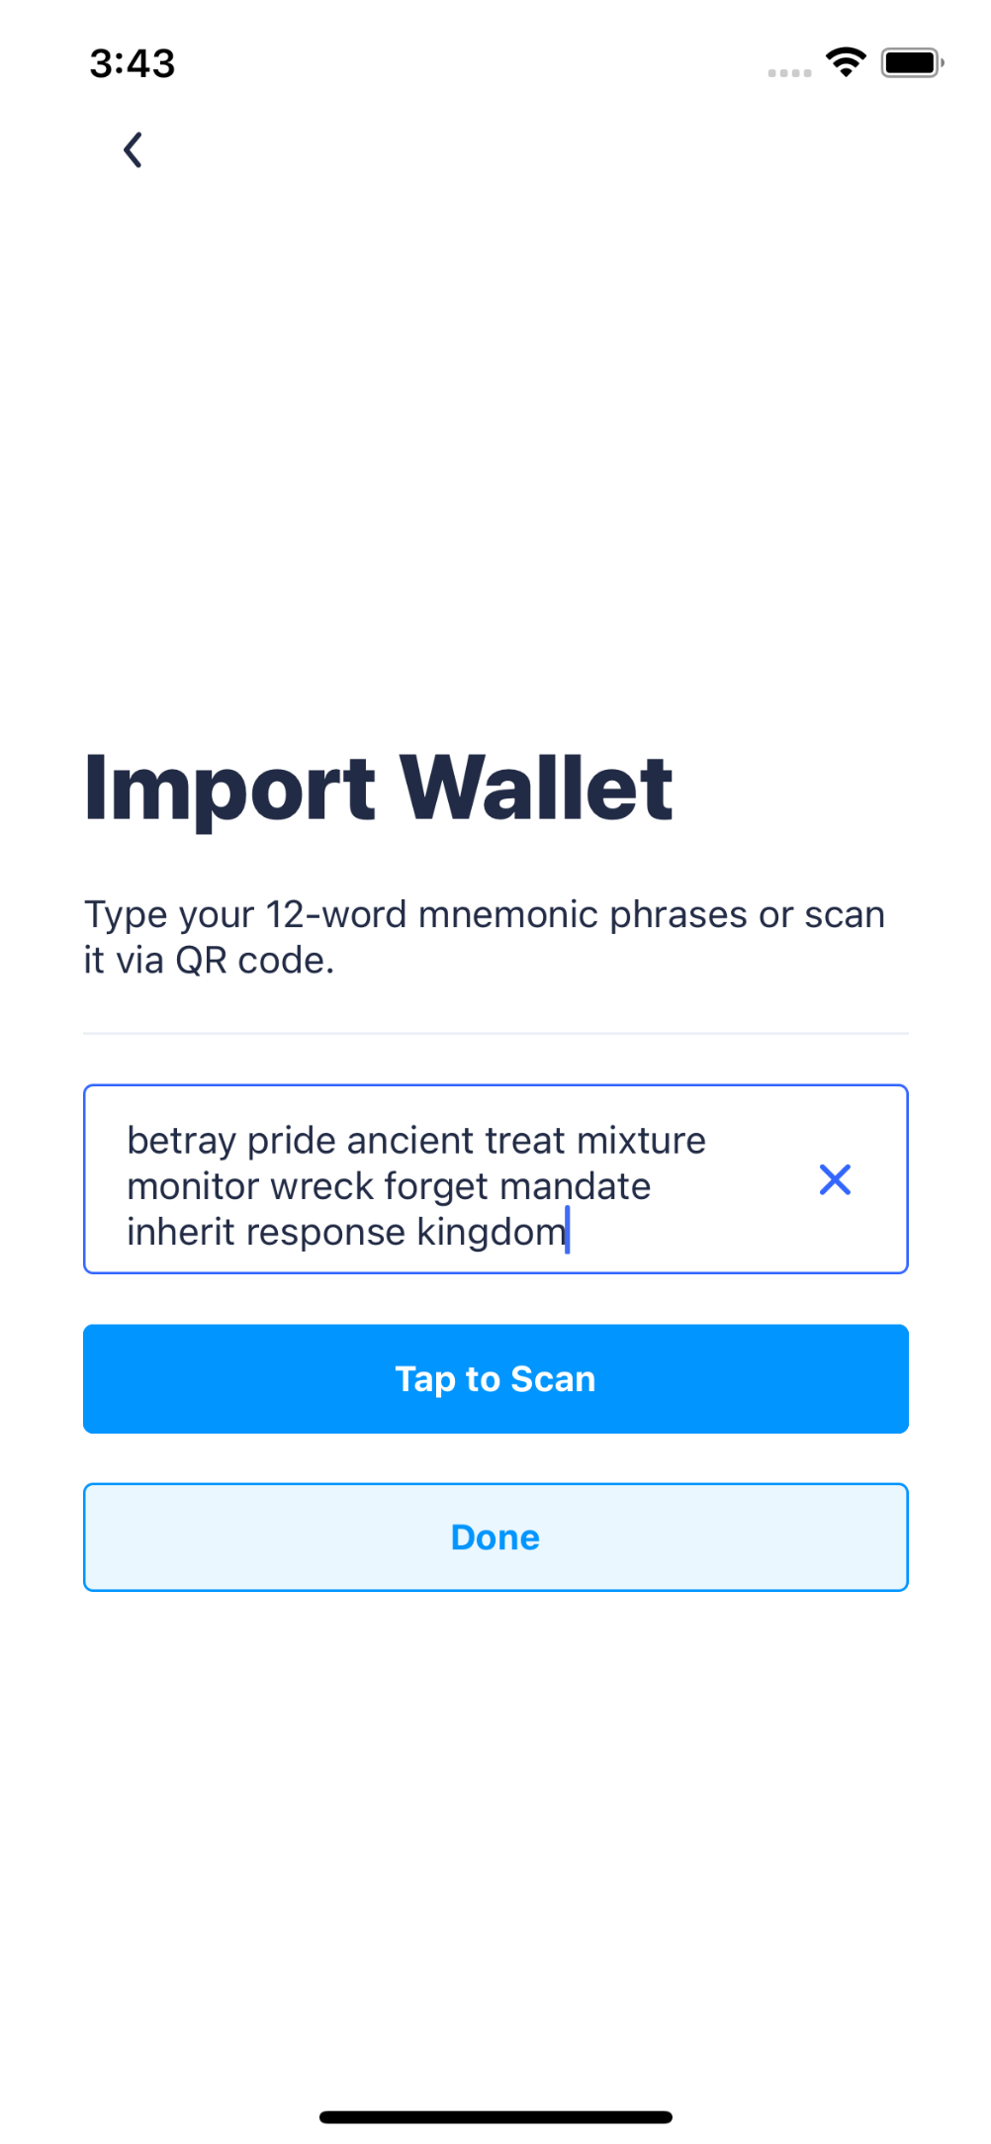
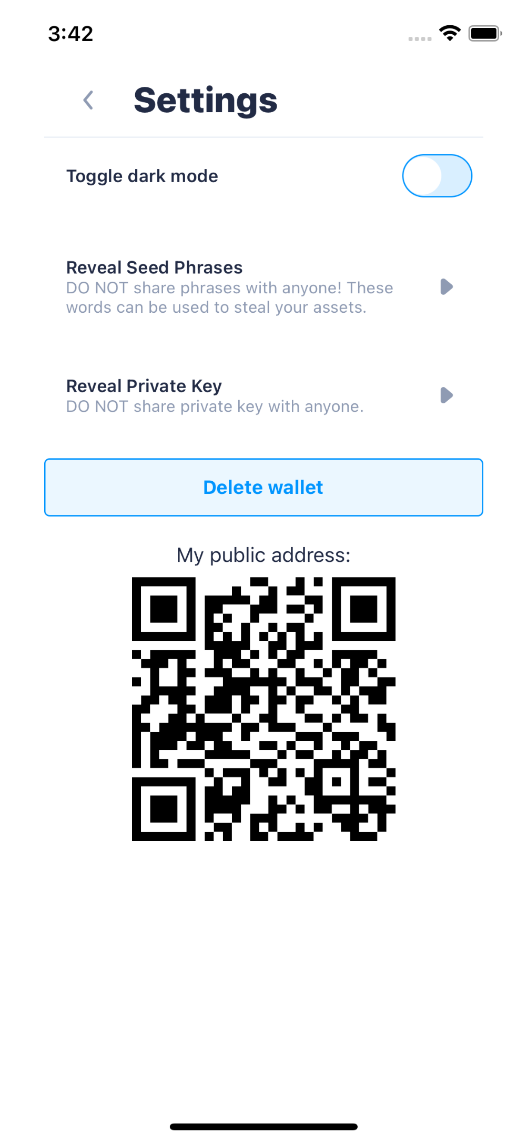
SUMMARY
Ethereum & ERC20 Token Wallet
Ismail Can Vardar
Software Engineering
2020-2021 Capstone Project
Make people who have assets on Ethereum blockchain access their wallets and carry out the transactions in secure and easy way.
Creating wallets on the Ethereum network can be complicated & cumbersome for end users and new users.
Accessing to the wallet is important for security, because any vulnerability could compromise the user's assets.
Most users need more flexible and customizable wallets with the latest blockchain technologies.
RESULT & DISCUSSION
People would be able to instantly generate a wallet with only one tap.
Device Authorization will allow users to secure their assets.
Users will have the ability to add new assets.
INTRODUCTION
Connecting user to the Ethereum blockchain in the fastest and most efficient way. Creating customizable interface where users can add new assets and interact them.
Designing smooth and understandable interface for people who newly stepped in cryptocurrency world.
RECOMMENDATIONS
To support multiple networks. (Testnets & local networks.)
To support multiple chains. (Avalanche, Binance Smart Chain etc.)
To fetch analytics of app usage.
METHOD
One of the methods used for this purpose is the use of local verification of the device. This can be listed as FaceID and TouchID on Android and iOS devices.
On the other hand, our second method is to be able to customize. For this purpose, thanks to Ethereum network, my app connects tokens on the Ethereum network to the wallet interface. In this way, the user can add tokens as desired and perform their transactions quickly.
In the application, users are be able to activate their wallets with a single button and transfer them to the application even if they already have a wallet created on another platform.
Figure 1 - Welcome screen has two buttons which are creating wallet & importing wallet.
Figure 2 - Home screen has wallet card which has current wallet balance and public address. Below, there are default token list and their balances as well.
Figure 3 – Sending transaction page that has asset name on the top position. Below there is public address input & people can scan it or select it from saved contacts. Last input is desired amount that will be sent.
RESOURCES
Library that makes app interact with Ethereum network: ethers.js
Gateway to Ethereum network which gives a blockchain node: Infura
Framework that is for developing mobile interfaces: React Native
Local device database for storing assets’ metadata & recipient addresses: SQLite
Similar project that is helpful for decentralized applications: ‎MetaMask
Figure 4 – Created wallet info screen that has mnemonic phrases to inform user about newly created wallet’s mnemonics. So user has to memorize or keep those phrases under safe place. After tapping next button user are directs towards Check Phrases page for confirmation.
Figure 5 – Add token bottom sheet which is located on home screen. By using this component user can add new asset to SQLite storage.
Figure 6 – Notifications screen that has lists which contains wallet’s previous activities & these data are fetched from etherscan.io’s API.
Figure 7 – Import wallet screen that has input which gets mnemonic phrases either scanning QR Code or typing. After that user can easily import by tapping Done button.
Figure 8 – Settings screen that user can reveal wallet’s private key or mnemonic phrases. In addition, user can show wallet’s public key as a QR Code. Besides, toggling dark mode is available feature.

